Slide 1
Introduction to Linux Day2: Mar 2023
Kiran Waghmare

Slide 2
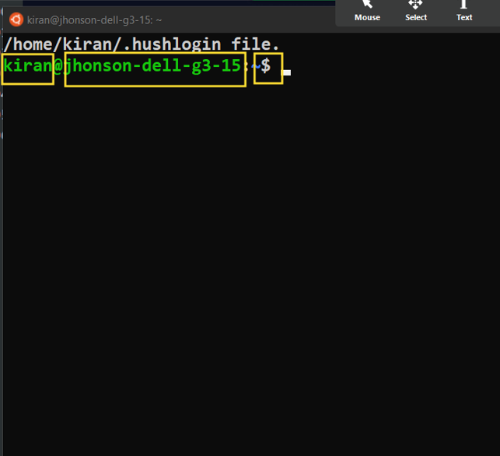

Slide 3
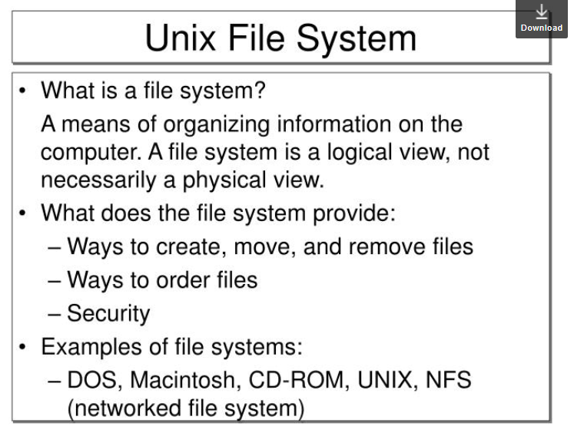

Slide 4
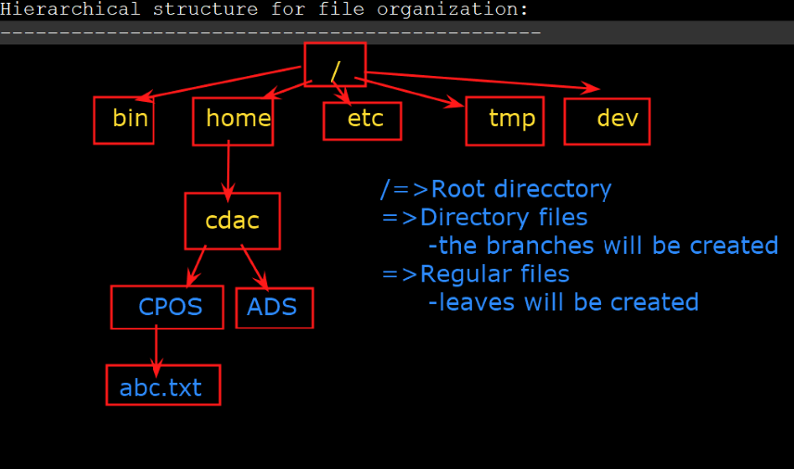

Slide 5
date
date -u
date +%a
date +%A
date +%b
date +%B
date +%y
date +%Y
cal
cal 10 2021
cal 5 2022
cal -j
cal -3
man cal
cal -m
cal -m 2021
cal 6 2021
whoami: know user
id: user details
pwd: present working directory
ls
ls -l
ls -t
ls -S
ls -h
ls -r
ls -a
ls -F
man ls
cd test1
cd ~
cd ..
cd ../ ../
cd -

Slide 6
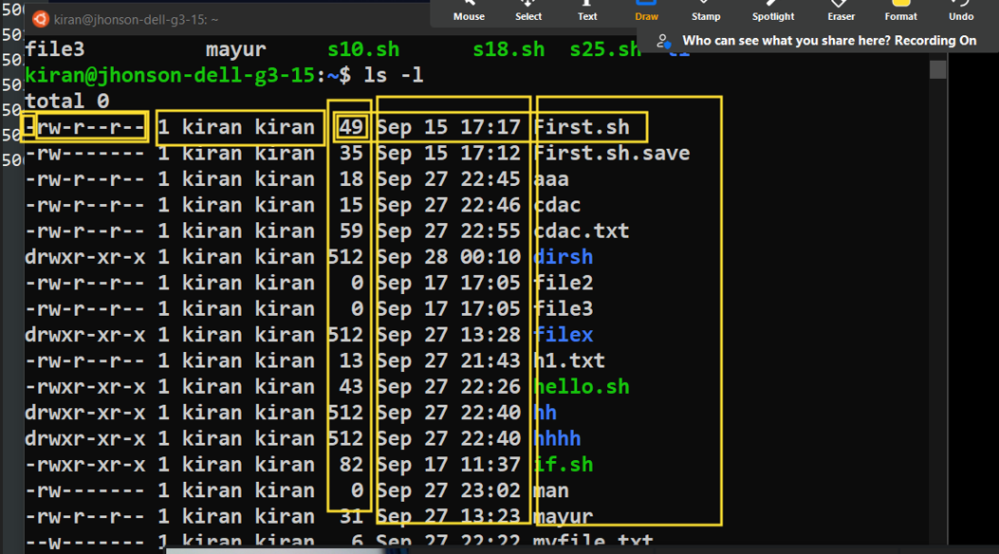

Slide 7
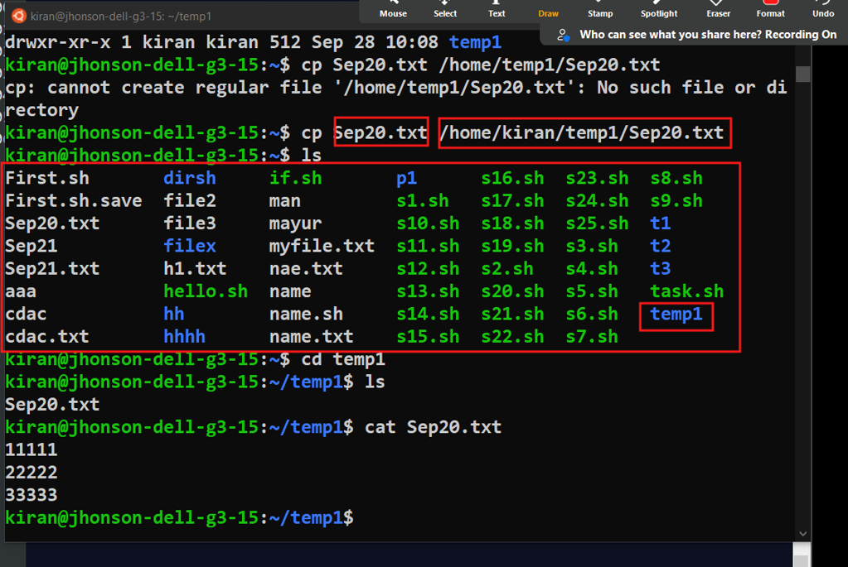

Slide 8
cat > March22
1
2
3
4
5
cat March22
cat > March22.txt
111
222
333
ls
mk dir temp1
cat >> sep20.txt
ls -l
wc -l h1.txt
wc -c h1.txt
echo "CDAC Mumbai!!!"
touch f1 f2 f3 f4 f5
cat f1
ls f*

Slide 9
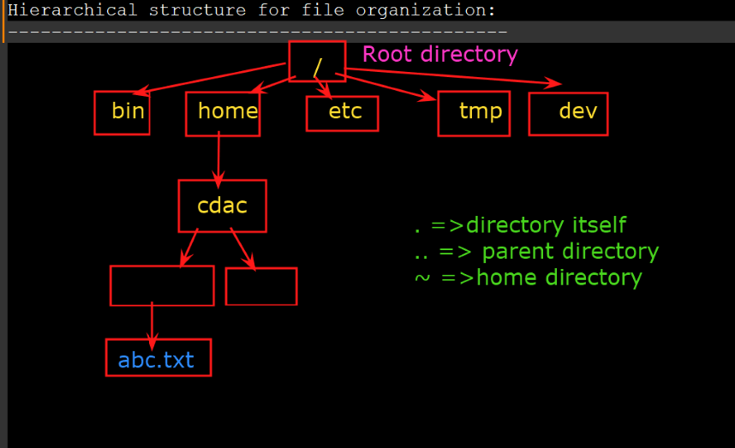

Slide 10
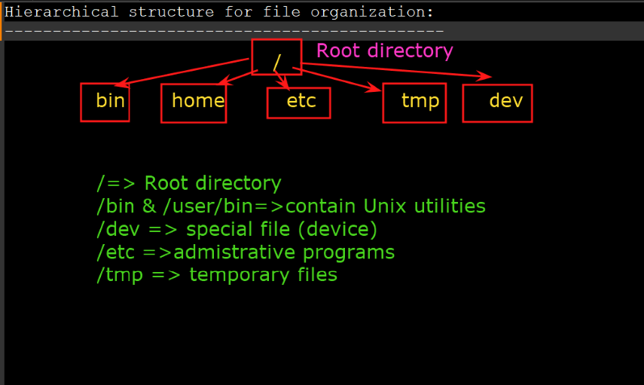

Slide 11
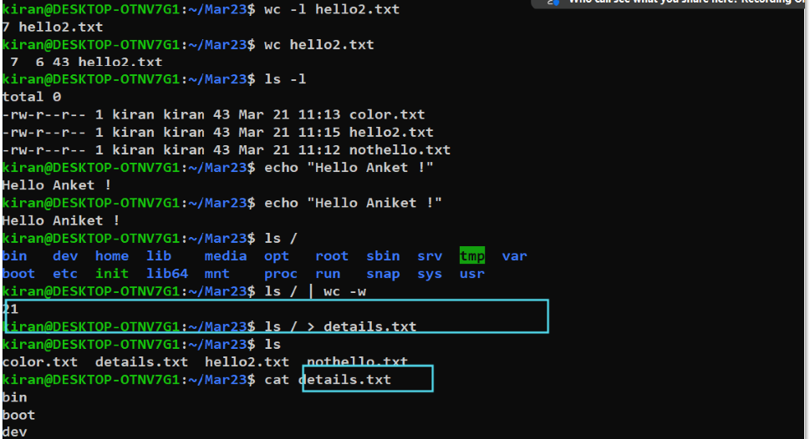

Slide 12
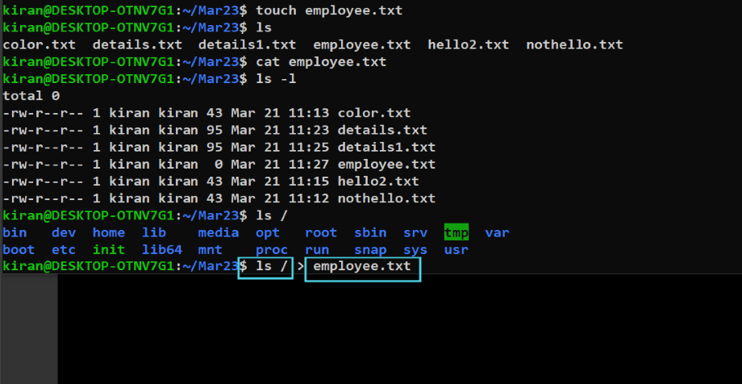

Slide 13
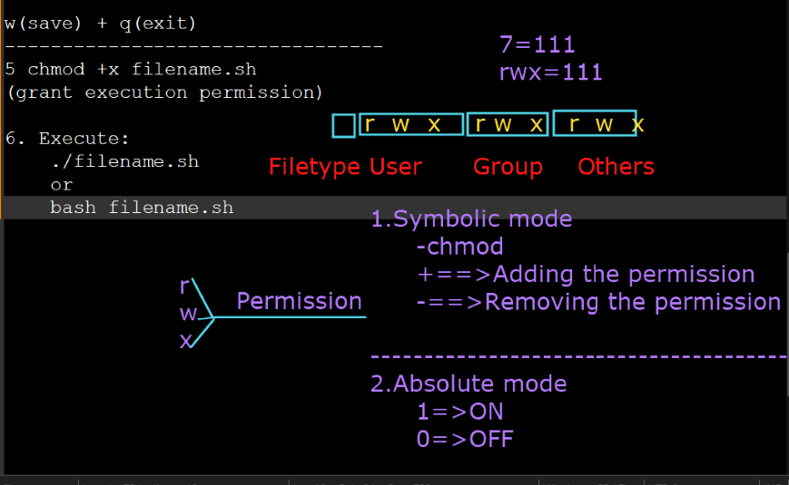

Slide 14
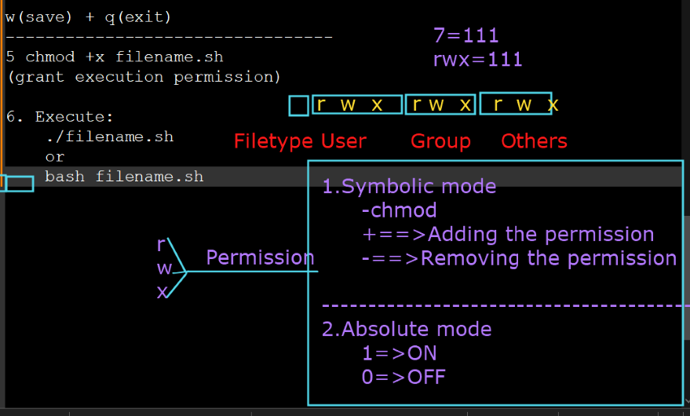

Slide 15
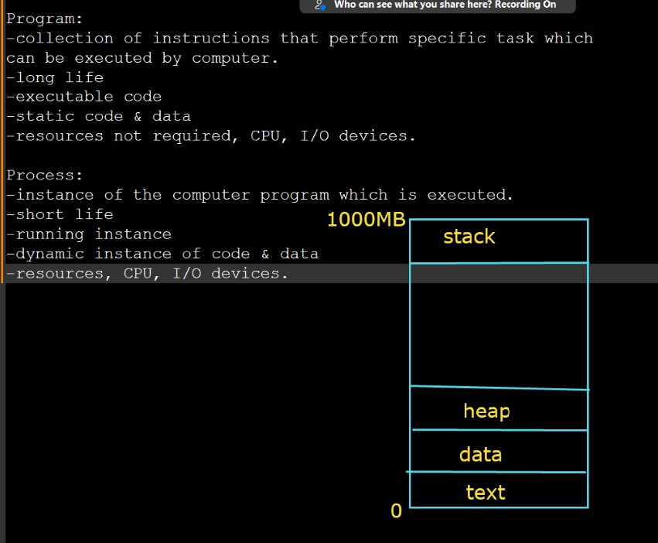

Slide 16
